Slide 1
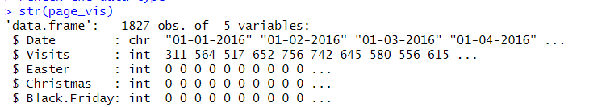
TIME SERIES FORECASTING USING FACEBOOK PROPHET IN R PROGRAMMING
Dataset consists of 1827 rows and 5 variables
Objective: To forecast the page visits of a website
Data cleaning: Formatted the date Date column by using “lubridate” package and convert it to a date vector from character vector. There was no missing data
Libraries used : dplyr, ggplot2, prophet, forecast,tidyverse
Renamed the column Date to ‘ds’ and Visits to ‘y’

Slide 2
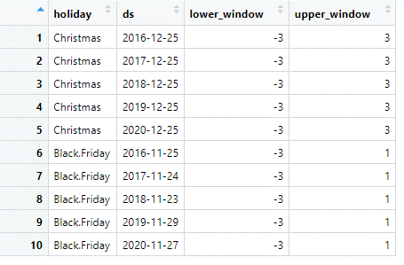
HOLIDAY EVENTS
Treat "Christmas" and "Black.Friday" as holiday events. As the data ranges from 2016 to 2020, there will be 5 Christmas and 5 Black Friday days
We will look at the impact of Christmas 3 days prior and 3 days later from Christmas date on and 3 days prior and 1 day later for Black Friday on "Visits"
We create two data frames called Christmas and Black.Friday and merge the two into a data frame called "holidays"

Slide 3
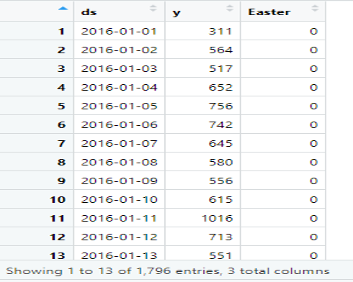
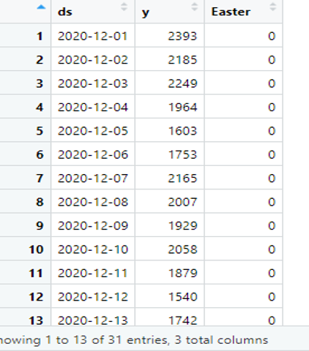
TRAIN AND TEST DATA
We create train and test data. In train data & test data, we select only 3 variables namely ‘ds’, ‘y’ , ‘Easter’. In train data, ds contains data before 2020-12-01 and test data contains data equal to and after 2020-12-01 (31 days) data
TRAIN DATA TEST DATA

Slide 4
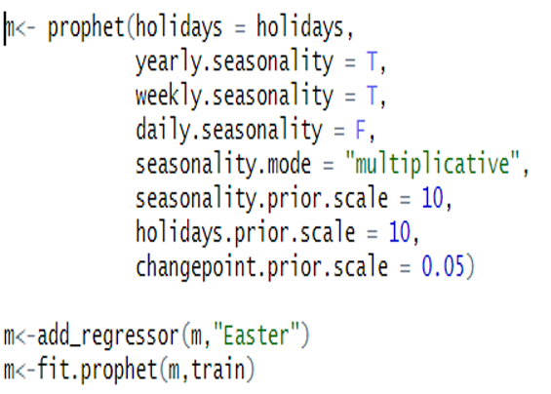
USING PROPHET FUNCTION
Use prophet model which will include multiple parameter. We are going with the default parameters. Thereafter, we add the external regressor "Easter"

Slide 5
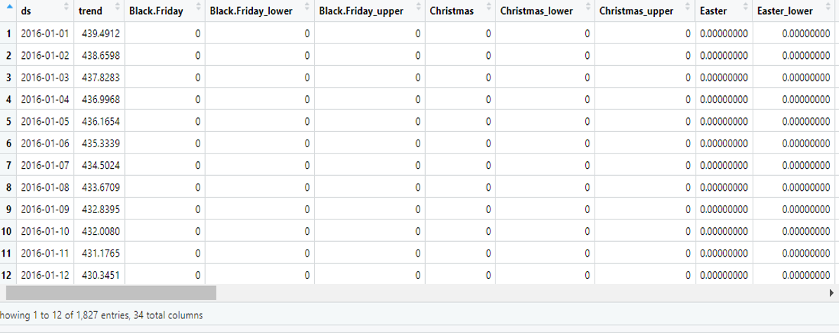
FUTURE DATA FRAME
We create the future data frame for forecasting and name the data frame "future". It will include "m" and 31 days of the test data. We then predict this future data frame and create a new data frame called "forecast".
Forecast data frame consists of 1827 rows and 34 variables. This shows the external Regressor (Easter) value is 0 through the entire time period. This shows that "Easter" has no impact or effect on "Visits".

Slide 6
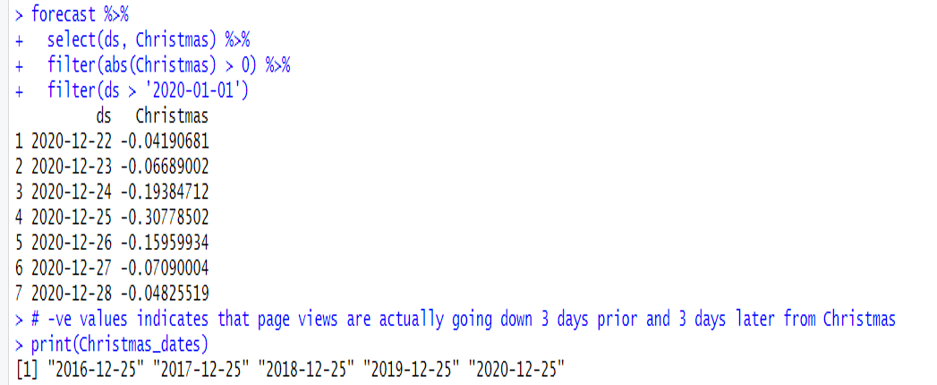
IMPACT OF CHRISTMAS ON VISITS
We try to understand the impact of Holiday events on Visits. Below is the impact of ‘Christmas’. It indicates that ‘Christmas’ had no impact on ‘Visits’ during the year 2020.

Slide 7
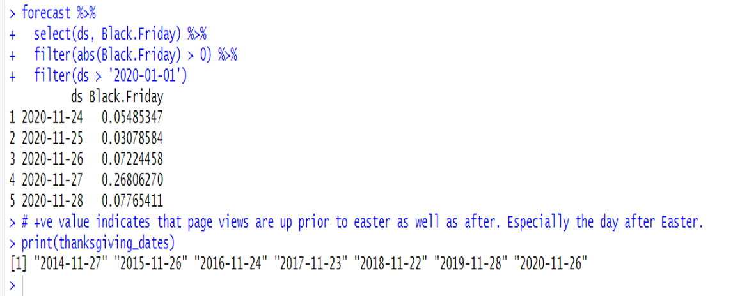
IMPACT OF BLACK FRIDAY ON VISITS
We try to understand the impact of Holiday events on Visits. Below is the impact of ‘Black Friday’. It indicates that ‘Black Friday’ has a very minimal impact on ‘Visits’

Slide 8
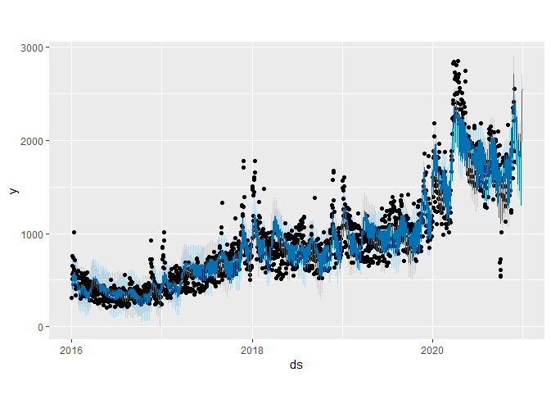
PLOT GENERAL FORECAST
plot(m,forecast)
Blue is predicted value(yhat) and black is actual value(y) and blue shaded regions are the yhat_upper and yhat_lower values (max and min predicted values)

Slide 9
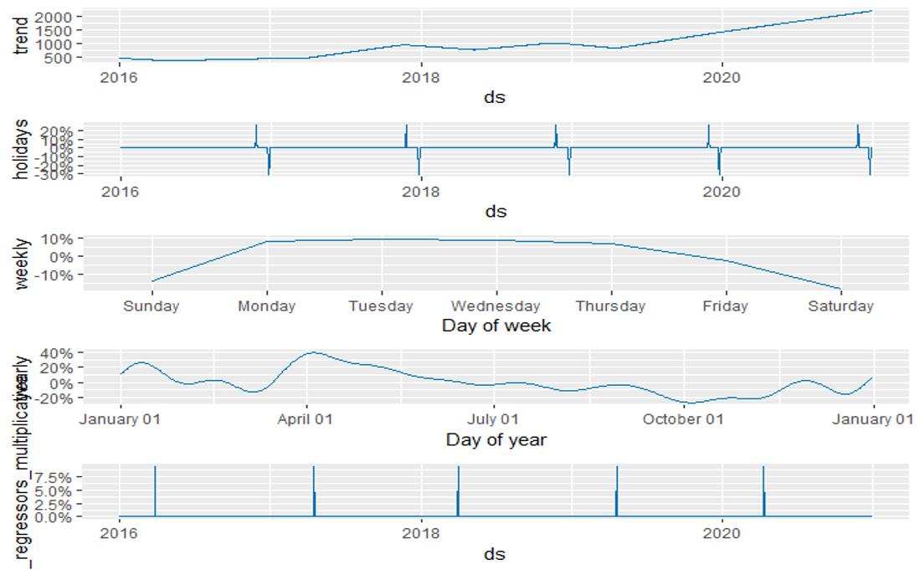
PLOT COMPONENTS

Slide 10
PLOT COMPONENTS INTERPRETATION
prophet_plot_components(m,forecast)
Trend indicates that the page visits remained constant from Jan'16 to Mid'17 and thereafter there was an upswing from Mid'19 to End of 2020
From Holidays, we can make out that Christmas had a negative effect on page visits whereas Black Friday had a positive effect on page visits
Weekly seasonality indicates that page visits tend to remain the highest from Monday to Thursday and starts going down thereafter
Yearly seasonality indicates that page visits are the highest in Apr and then starts going down thereafter with Oct having reaching the bottom point
External regressor "Easter" has no impact on page visits

Slide 11
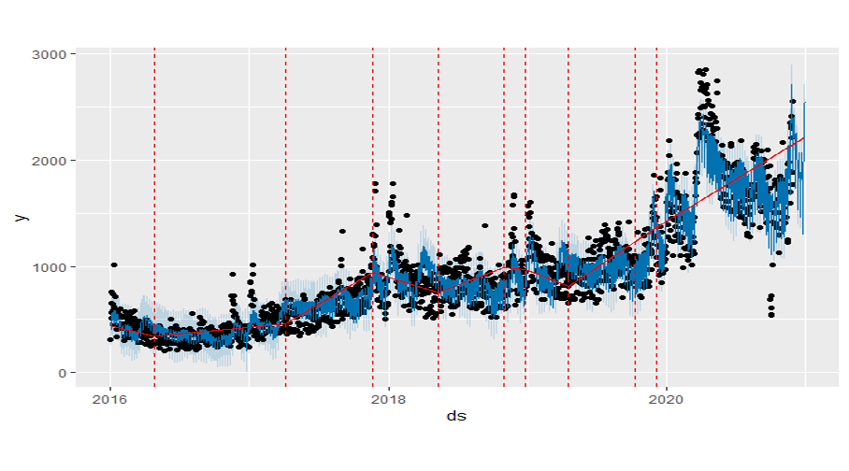
PLOT TREND FORECAST
plot(m,forecast) + add_changepoints_to_plot(m)
Trend which is indicated by the red line starts moving upwards from Mid 2019 to 2020 onwards

Slide 12
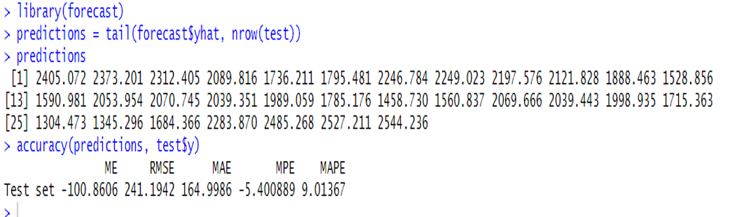
PREDICTING ACCURACY, RMSE AND MAPE
We check for accuracy of the model. RMSE is 241.1942 , MAPE is 9.01, Accuracy is 90.99%

